Slide 1

Hospital Management
M Y S Q L
BY / -
Surender (21AG1A0502)
Venu (21AG1A0513)
Sai (21AG1A0524)
Nanda (21AG1A0539)

Slide 2
Contents
1
Introduction
This gives a brief Introduction about Hopital Management using E.R Diagram & SQL Queries.
2
Explanation
E.R Diagram,SQL Query,(with outputs) and Benﬁts
This gives E.R Diagram, Databasescheme and SQl Query of our Project.
3
Conclusion
Thus the Needs and conclusion of our project

Slide 3


H M S
(Hospital Management System).
Hospital Management System with SQL and Represented by E.R Diagram.
Hospitals interact with a lot of people in a day and
there are various activities involved in day to day operations of hospitals, for example booking of appointments, managing doctor schedules, managing patient diagnoses, managing medical histories of patients, etc.
The aim of this project is to show how data related to these tasks can be made easier to manage using databases.

Slide 4



SQL :
SQL (Structured Query Language) is used to perform operations
on the records stored in the database.
This database language is mainly designed for maintaining the data in relational database management systems.
It is a special tool used by data professionals for handling structured data (data which is stored in the form of tables). It is also designed for stream processing in RDSMS.

Slide 5
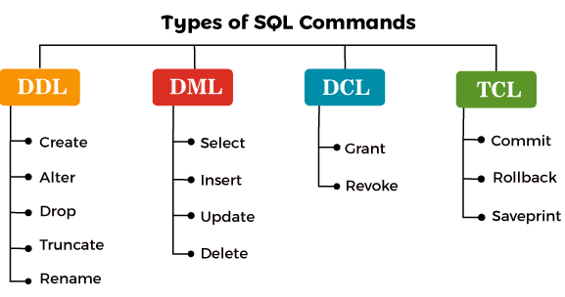

Slide 6


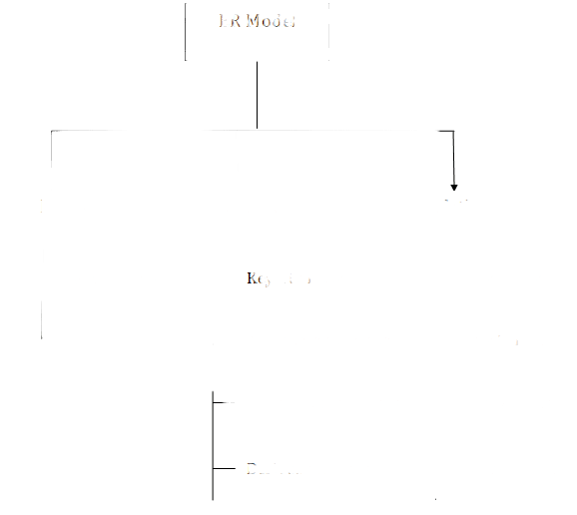
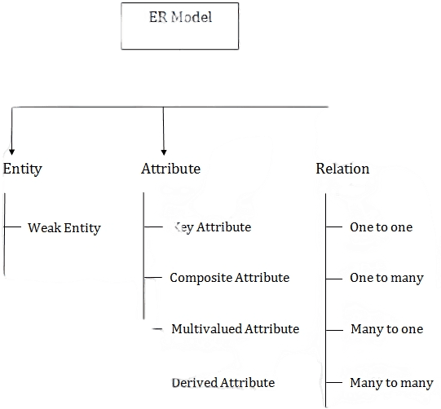
E.R Diagram
ER model stands for an Entity-Relationship model.
It is a high-level data model. This model is used to deﬁne the data elements and relationship for a speciﬁed system.
It develops a conceptual design for the database. It also develops a very simple and easy to design view of data.
In ER modeling, the database structure is portrayed as a diagram called an entity- relationship diagram.

Slide 7
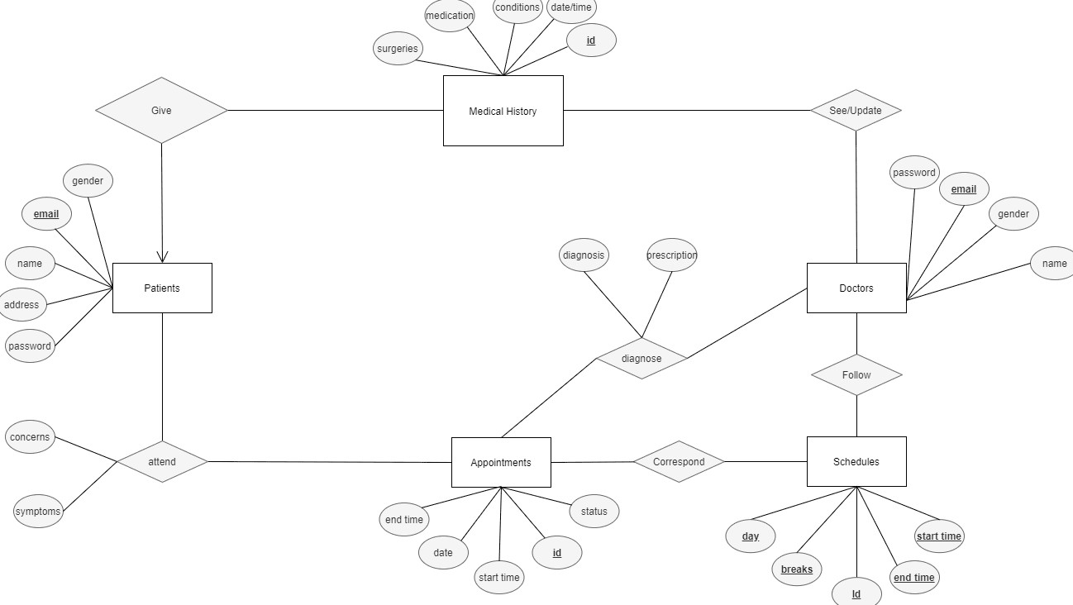

Slide 8
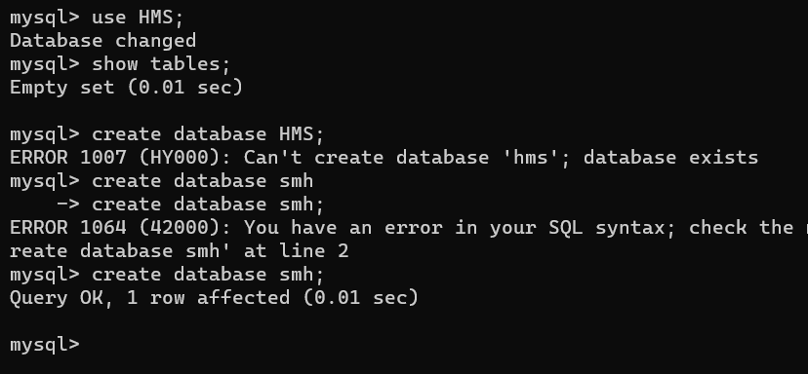
*. Creation of DataBase
Create database HMS;
Use HMS;
show tables;

Slide 9
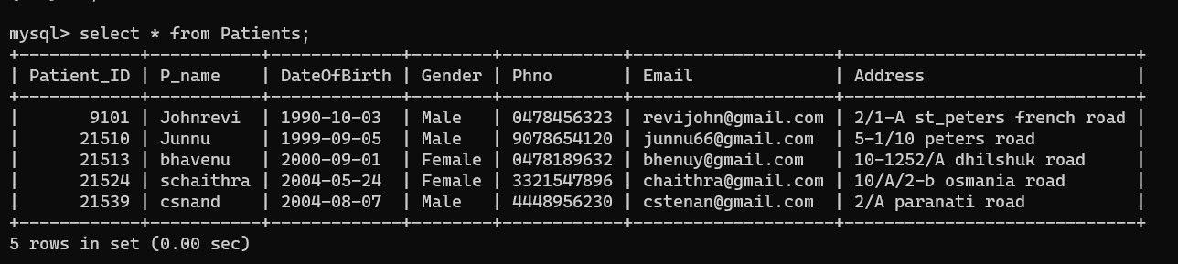
Creation of Tables in HMS:
Patient Table:
CREATE TABLE Patients (
Patient_ID INT PRIMARY KEY,
P_name VARCHAR(50),
DateOfBirth DATE,
Gender VARCHAR(10),
Phno VARCHAR(15),
Email VARCHAR(100), Address TEXT );

Slide 10
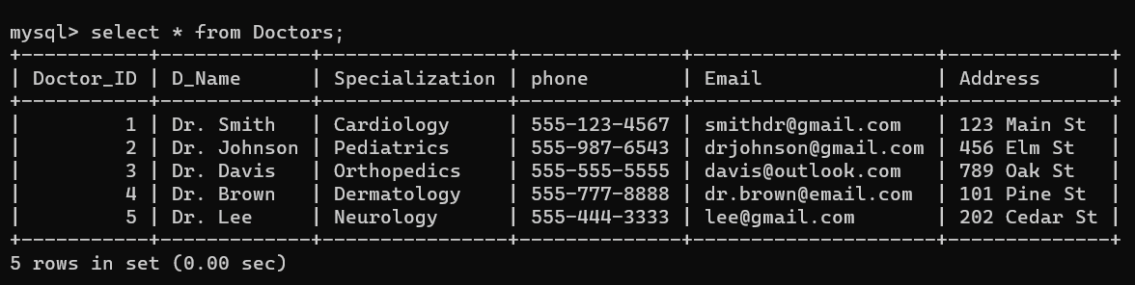
Doctors Table:
CREATE TABLE Doctors (
Doctor_ID INT PRIMARY KEY,
D_Name(50),
Specialization VARCHAR(100),
Phone VARCHAR(15),
Email VARCHAR(100),
Address TEXT );

Slide 11
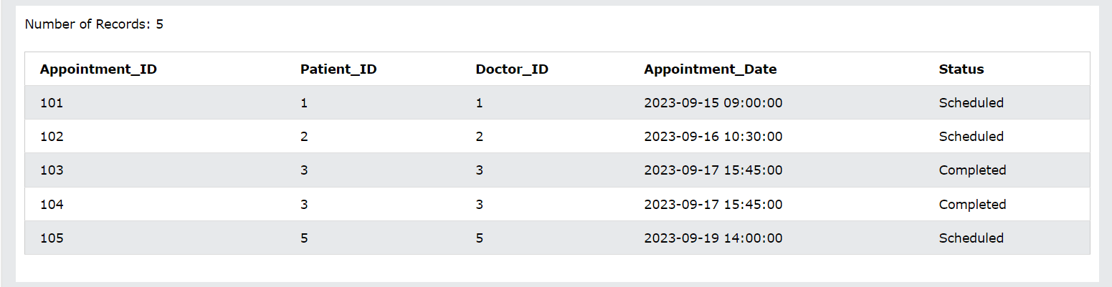
Appointments Table:
CREATE TABLE Appointments (
AppointmentID INT PRIMARY KEY,
PatientID INT,
DoctorID INT,
AppointmentDate DATETIME,
Status ENUM('Scheduled', 'Cancelled', 'Completed'),
FOREIGN KEY (PatientID) REFERENCES Patients(PatientID),
FOREIGN KEY (DoctorID) REFERENCES Doctors(DoctorID) );

Slide 12
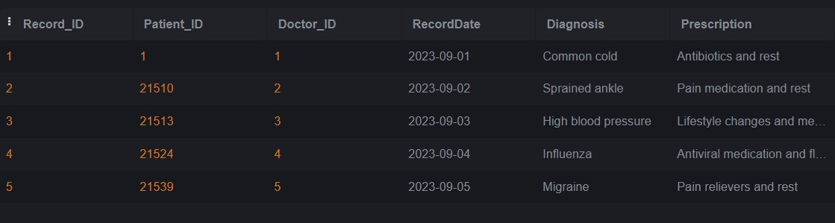
Medical Records:
CREATE TABLE MedicalRecords ( Record_ID INT PRIMARY KEY, Patient_ID INT,
Doctor_ID INT,
RecordDate DATE, Diagnosis TEXT,
Prescription TEXT,
FOREIGN KEY (Patient_ID) REFERENCES Patients(PatientID),
FOREIGN KEY (Doctor_ID) REFERENCES
Doctors(Doctor_ID) );

Slide 13
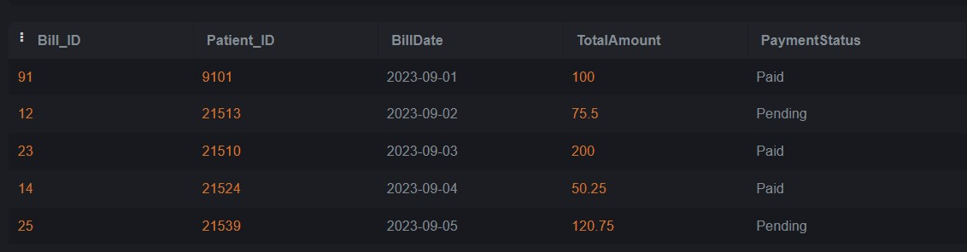
Billing Table :
CREATE TABLE Billing (
BillID INT PRIMARY KEY,
PatientID INT,
BillDate DATE,
TotalAmount DECIMAL(10, 2), PaymentStatus ENUM('Pending', 'Paid'),
FOREIGN KEY (PatientID) REFERENCES
Patients(PatientID) );

Slide 14

Benefits:
Time-saving technology
Improved efficiency by avoiding human errors
Reduced scope for error
Data security and correct data retrieval
Cost effective and easily manageable
Easy access to patient data with correct patient
history
Improved efficiency of the staff
Manages hospital facilities efficiently
The use of technology reduces the time
consumption.

Slide 15
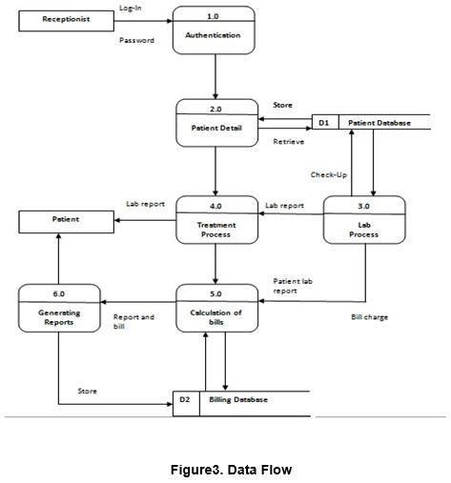
Some more Beneﬁts:
Role-based access control
Data accuracy
Revenue management
Appointment booking
Overall cost reduction
Data security

Slide 16
Conclusion:
A Hospital Management System using SQL is essential for improving patient care and operational efficiency in healthcare institutions, offering data security, flexibility, and compliance.
Hospital Management System utilizing SQL is pivotal in enhancing healthcare quality and efficiency. It empowers healthcare professionals with rapid, accurate access to patient data, streamlining workflows and reducing errors. The robust security features of SQL databases ensure patient data remains protected, adhering to regulatory standards like HIPAA.

Slide 17


Thanks!
V4

